Slide 1
Artistic Composition for Painterly Rendering
Lindemeier, Thomas; Spicker, Marc; Deussen, Oliver;
University of Konstanz
Vision, Modeling and Visualization 2016
Session: Image Editing and Exploration

Slide 2
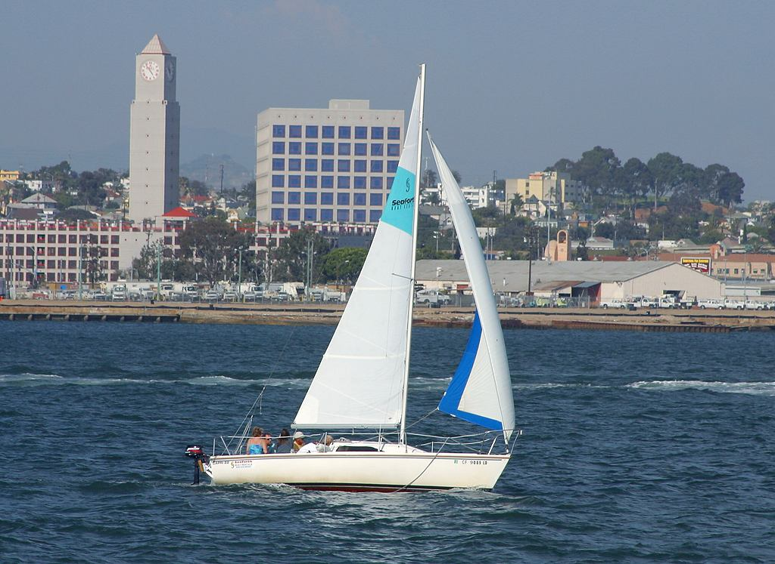
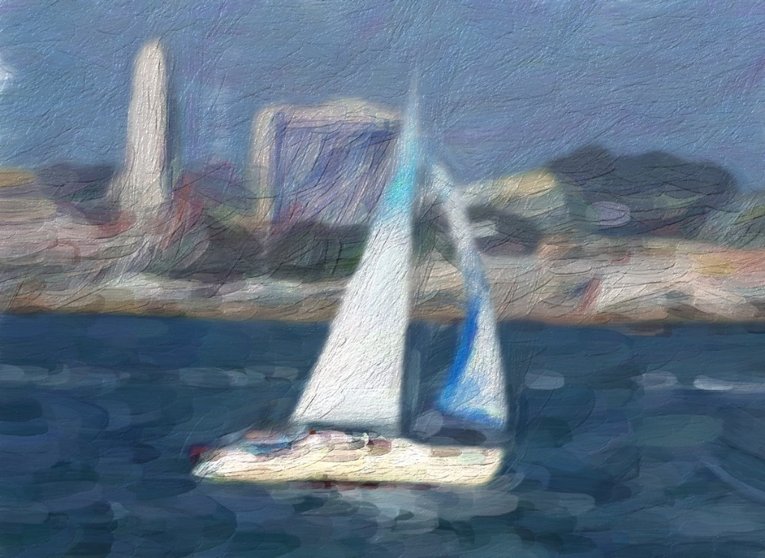
Painterly Rendering
Generate painterly images from photographs
Zhao and Zhu 2010, Sisley the Abstract Painter
Notes:
Generate an image that looks like it has been painted. A digital source image is transformed int such a way that it looks painterly.
In General, stroke-based rendering works as follows:
Input image, orientation field, brush stroke parameters.
Seed points, grow strokes. Goal is to minimize input canvas distance (pixelwise color distance).
For each brush stroke the color is selected from the input image.
Sometimes a postprocessing step is applied, that transfers the colors. For example warmer colors.
Software Result:
@inproceedings{sisley-npar10, author = {Mingtian Zhao and Song-Chun Zhu}, title = {Sisley the Abstract Painter}, booktitle = {NPAR '10: Proceedings of the 8th International Symposium on Non-Photorealistic Animation and Rendering}, year = {2010}, isbn = {978-1-4503-0125-1}, pages = {99--107}, location = {Annecy, France}, doi = {http://doi.acm.org/10.1145/1809939.1809951}, publisher = {ACM}, address = {New York, NY, USA}, }

Slide 3
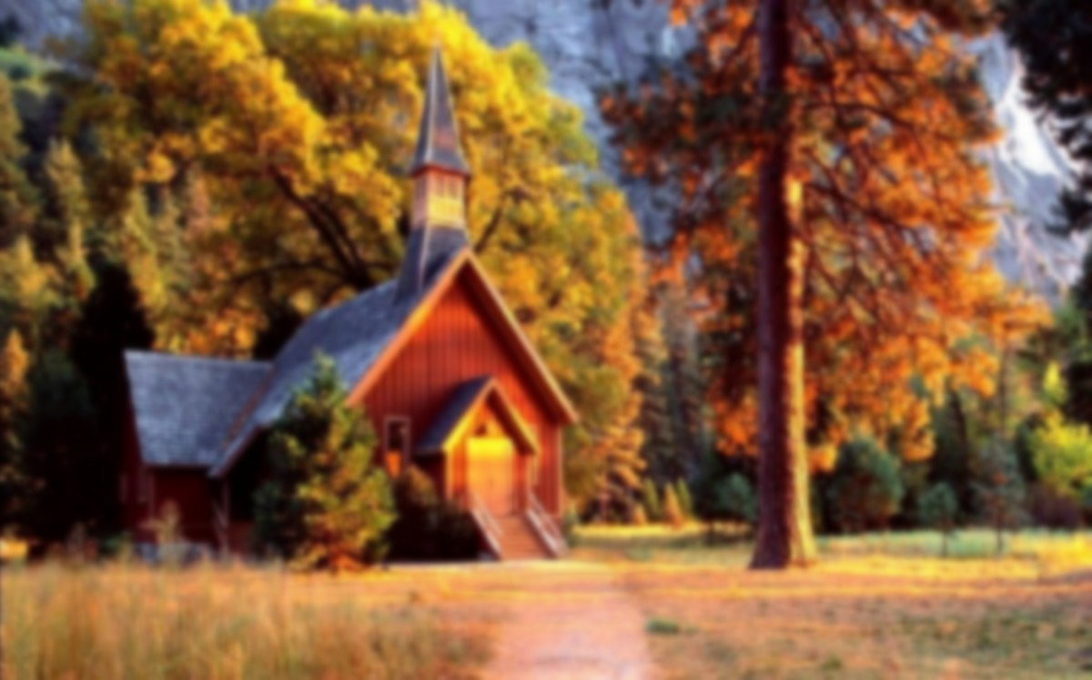

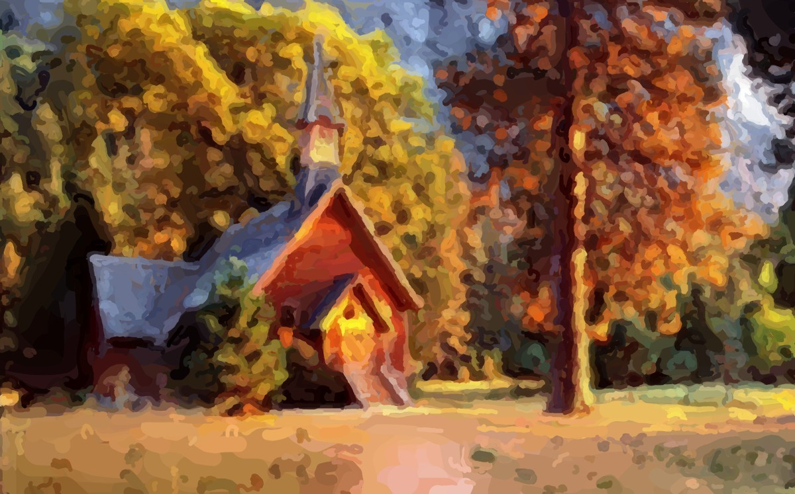

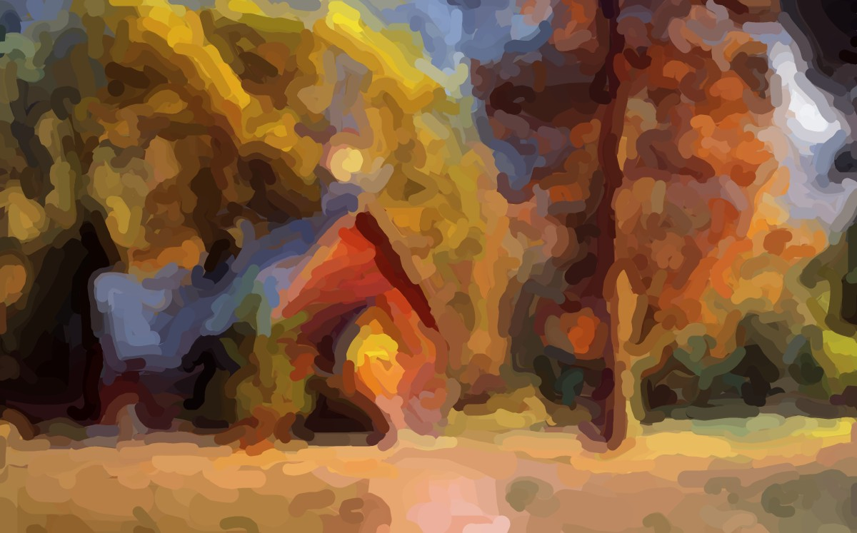
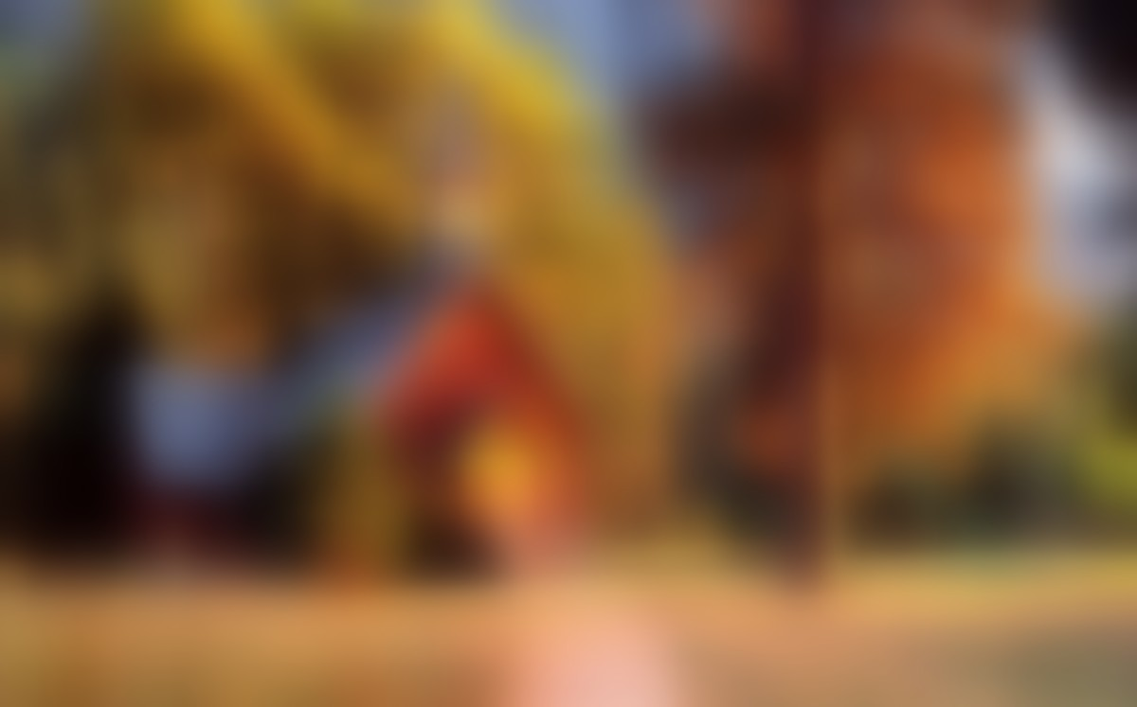
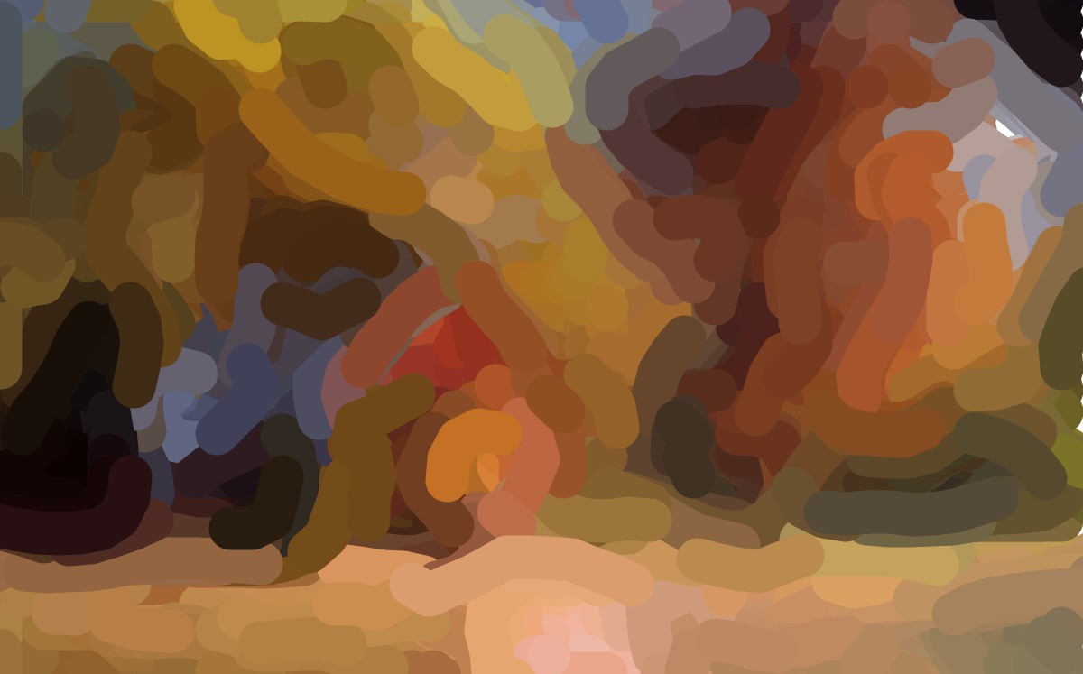

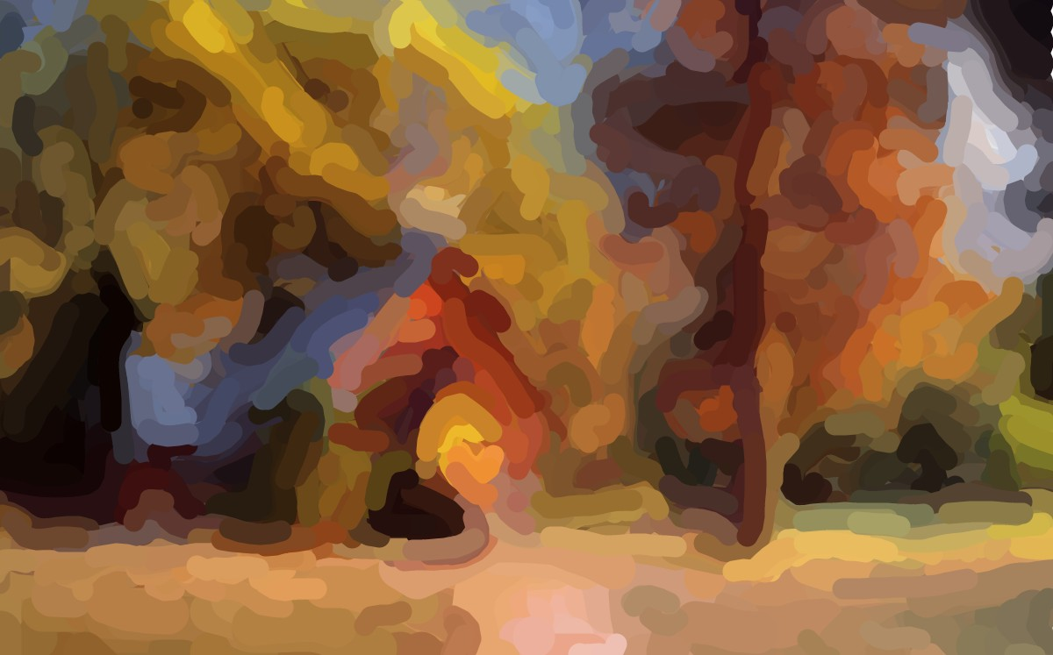
Painterly Rendering
Typical strategy
Lots of strokes and colors!
Notes:
Involves blurring, different scales according to brush sizes.
At every bur scale colors are averaged and chosen as brush color.
Each finer brush level tries to correct the error introduced by the larger brush (example roof and gable )

Slide 4
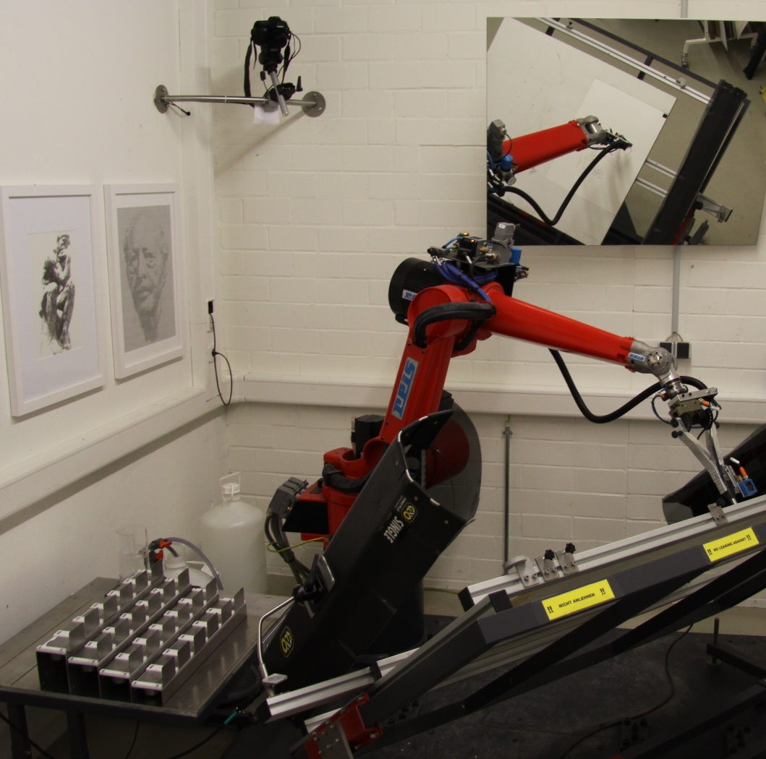
Painting Machines
e-David
Six axis robot
24 color pots
Camera for visual feedback
Acrylic paint

Slide 5
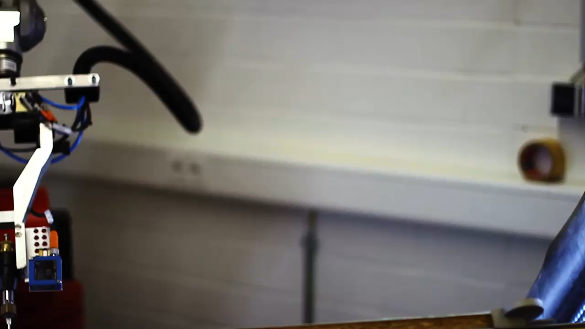
Painting Machines - e-David
Notes:
Repeat the problem -> lok in the real world, human painters real brushes, real color

Slide 6
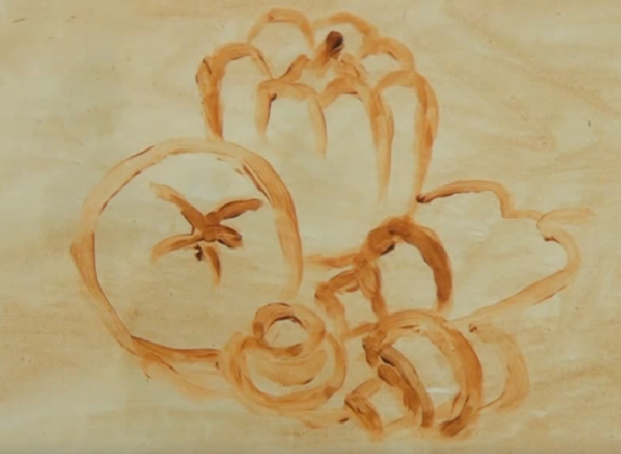
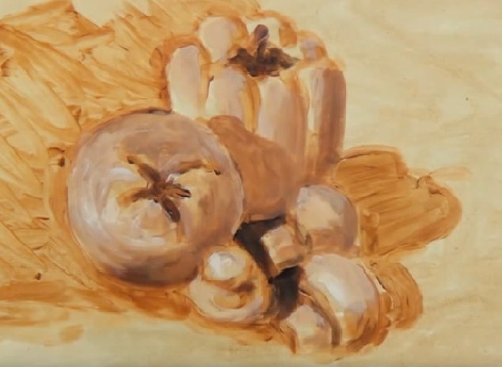
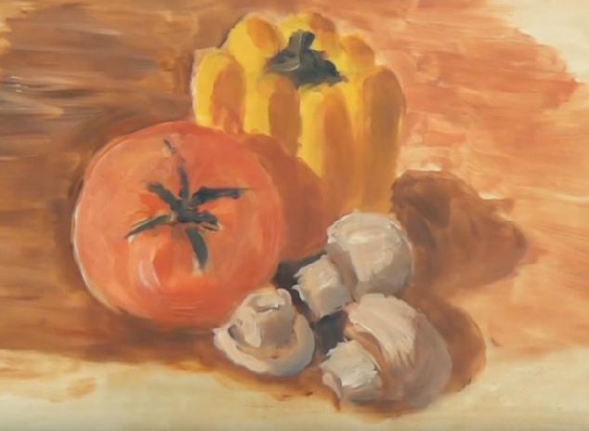
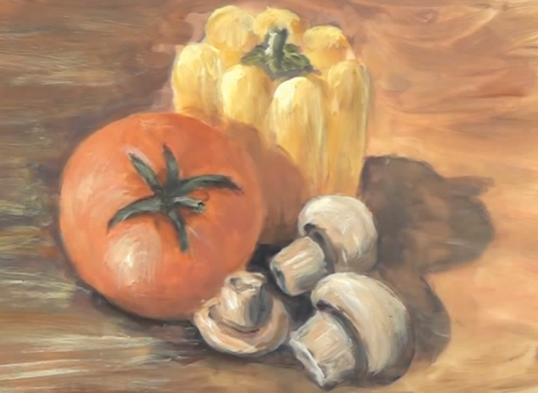
Human Painters
Outlines
Tonal values
Coloring
Refinement
Notes:
Painterly rendering produces images that look like artworks, the way to achieve that differs from what is done in reality.
For a painting machine, we have to consider what humans do, because they use the same tools. What can we use from there to generate painterly images from digital input images, with a painting machine such as e-david.
We do not extract lightsources -> no highloights. Would also need to hardcode or learn how to paint highlights

Slide 7
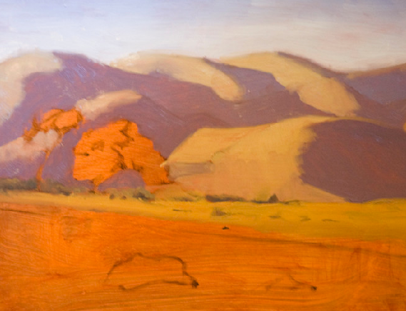
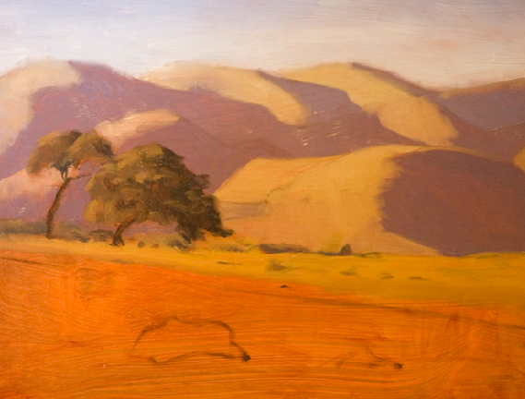
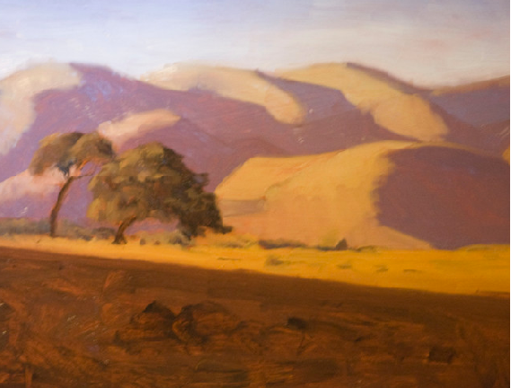
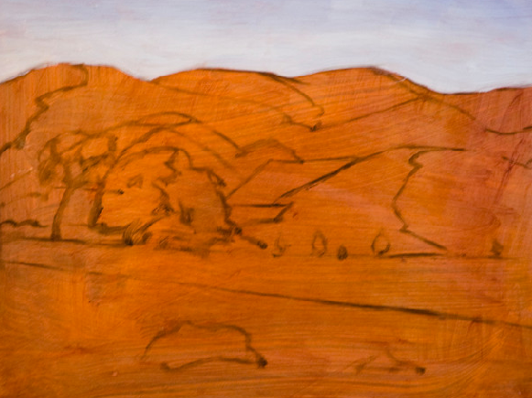
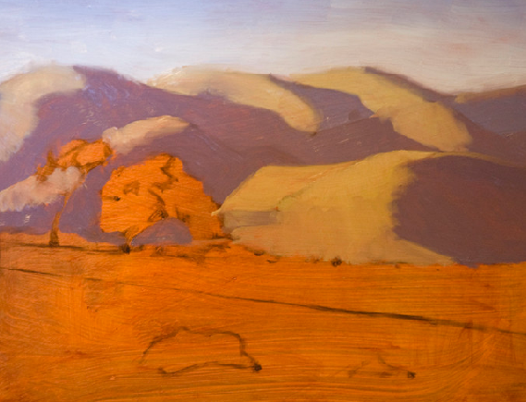
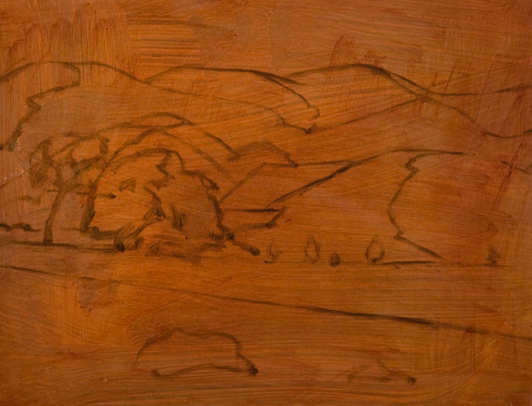
Human Painters
Back- and foreground regions
Back to front
Coarse to fine
Different strategies and tools
Notes:
Human artists also in the real world, real colors brushes and canvas:
How do they do it?
Follows basic human strategy
Reduces number of strokes and colors
Is applicable to software systems and painting machines
Offers more artistic freedom

Slide 8
Our Method:
Decomposition
Regions: spatial arrangement and order
Layers: application of tools (brushes)
→Reduces number of strokes and colors
Software systems and painting machines
Different painting styles for regions
Artistic freedom
Notes:
Takes everything what we can use from existing software based methods and combines it with the basic human strategy
The regions reflect the spatial arrangement of the composition and the order in
which the painting is to be created (typically back to front), and are produced in a way that new strokes only minimally paint
over existing ones.
Layers reflect the application of tools and are optimized for certain brush
sizes. The number of strokes and colors that are needed to
represent an input image are minimized by this decomposition, which is good for software, but essential for hardware-based rendering.
Our method allows us to apply different painting styles to different regions as well as layers, and to create
painterly renderings with more artistic freedom.

Slide 9
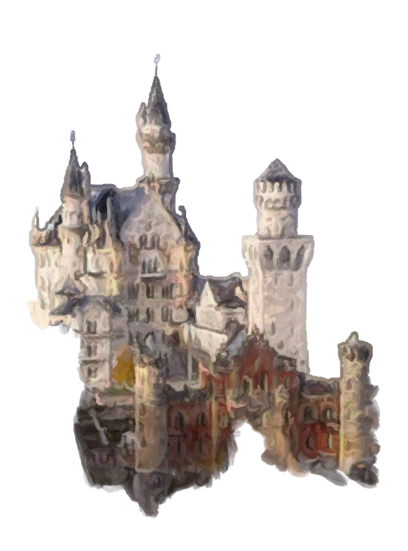
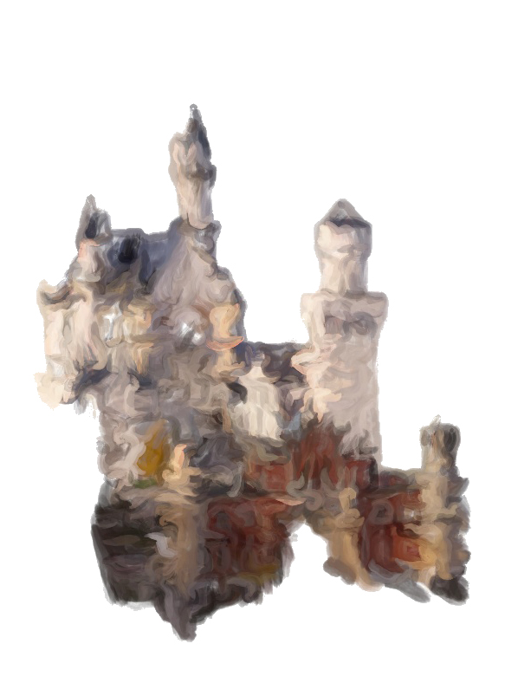
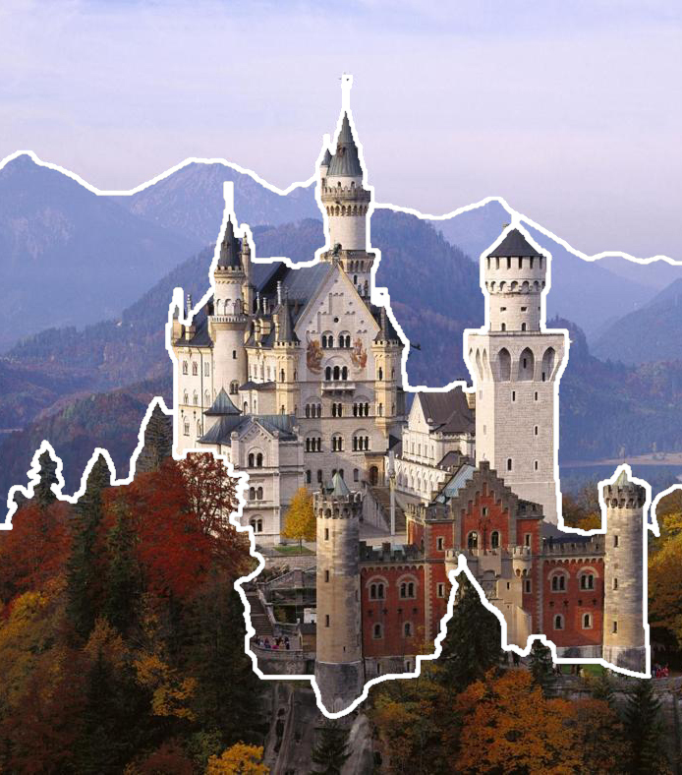
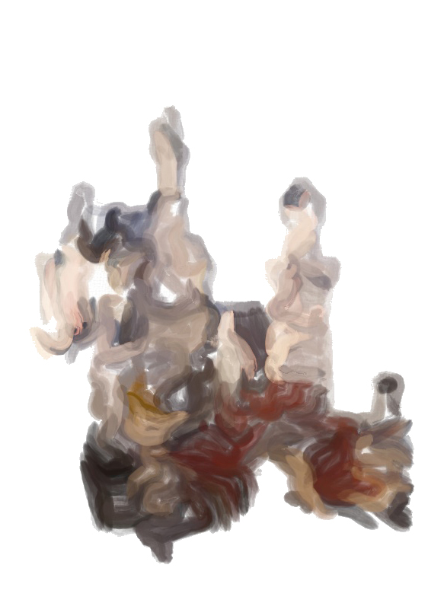
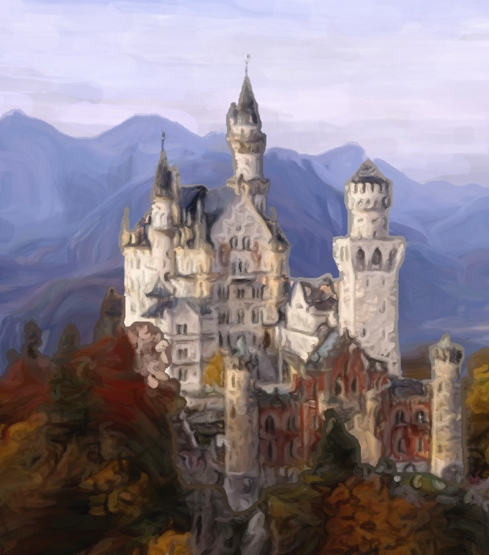
Our Method
1
2
3
4
Decomposition:
regions and layers
Composition:
per region, back to front and coarse to fine
Result
Notes:
Software renderer!

Slide 10
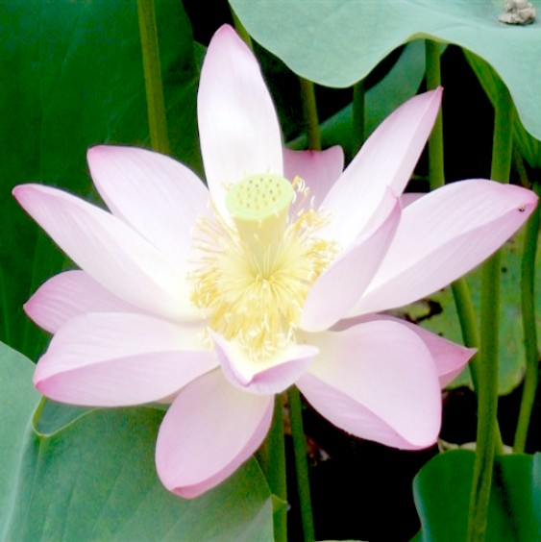
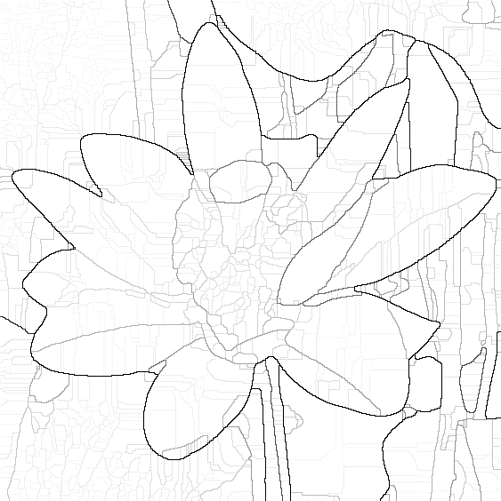
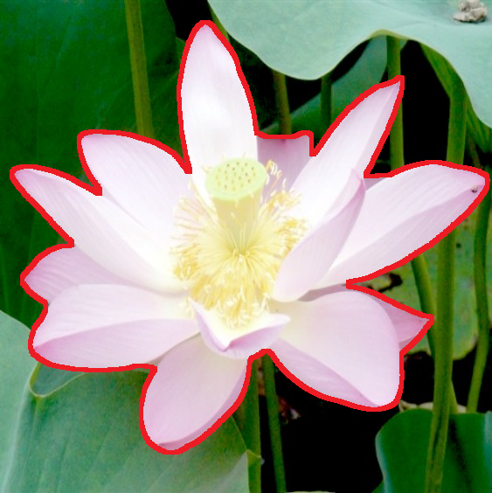
Division into Regions
Segmentation method by Arbelaez et al. 2009
Hierarchical
Interactive
Ultrametric contour map
Thresholding
Connected component analysis
Notes:
@INPROCEEDINGS{Arbelaez2009,
author={Arbelaez, P. and Maire, M. and Fowlkes, C. and Malik, J.},
booktitle={Computer Vision and Pattern Recognition, 2009. CVPR 2009. IEEE Conference on},
title={From contours to regions: An empirical evaluation},
year={2009},
pages={2294-2301},
keywords={feature extraction;image segmentation;transforms;OWT-UCM algorithm;generic grouping algorithm;hierarchical segmentation;high-performance contour detector;oriented watershed transform;state-of-the-art image segmentation;ultrametric contour map;user-specified annotation;Brightness;Detectors;Image edge detection;Image segmentation;Inference algorithms;Leak detection;Level set;Machinery;Object recognition;Pixel},
doi={10.1109/CVPR.2009.5206707},
ISSN={1063-6919},
month={June},}

Slide 11

Division into Regions - Boundaries
Artists extend background regions towards foreground regions
Sharp boundaries
Dilation at boundaries towards subsequent regions
Color diffusion
Notes:
Boundaries to subsequent regions have to be processed with an additional step. This enables to create sharp boundaries.
Actually, human artists tend to do that even more, but we want to save strokes.

Slide 12
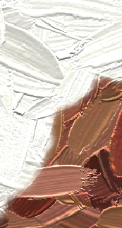
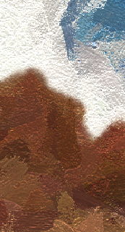
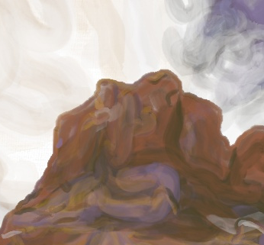
Outlining Boundaries
Outlining regions
Sharper boundaries
Extract contours
Paint along to the contours with an offset (corresponds to brush radius)
Zeng et al. 2009
Our result
Notes:
@article{Zeng2009,
author = {Zeng, Kun and Zhao, Mingtian and Xiong, Caiming and Zhu, Song-Chun},
title = {From Image Parsing to Painterly Rendering},
journal = {ACM Trans. Graph.},
issue_date = {December 2009},
volume = {29},
number = {1},
month = dec,
year = {2009},
issn = {0730-0301},
pages = {2:1--2:11},
articleno = {2},
numpages = {11},
doi = {10.1145/1640443.1640445},
acmid = {1640445},
publisher = {ACM},
address = {New York, NY, USA},
keywords = {Image parsing, nonphotorealistic rendering, orientation field, painterly rendering, primal sketch},
}

Slide 13
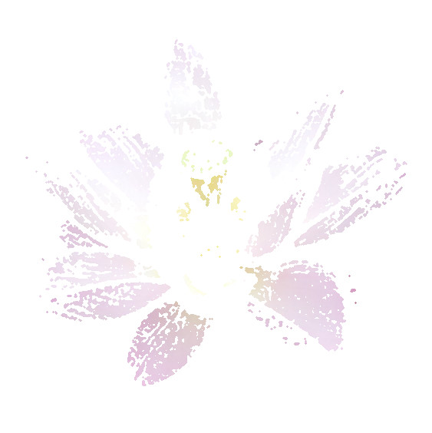

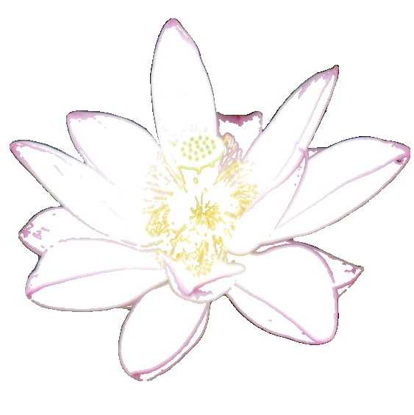
Division into Layers
Extraction
Input region flower
Coarse
Medium
Fine
Lu et al. 2010
Notes:
First and second Gaussian derivatives at six orientations
Thresholding the response to create coarse, medium and fine layers

Slide 14
Composition – Creating the Painterly Representation

Slide 15

Notes:
Decomposition as preprocessing. Composition to put it al together. We are able to fill in here all kinds of painterly rendering methods to distribute the seed points and create strokes.
Here we used grid based sampling and an orientation field created from structure tensors created from color gradients.

Slide 16
Painting Layers
Coarse to fine
Feedback loop (Deussen et al. 2012,Lindemeier et al. 2015)
Layer and region masks
CIELab color distance
Stroke (seed) sampling
Lloyd Relaxation, grid or rejection
Stroke orientations
Structure tensors
Color selection
From input if continuous palette
NN of palette
Brush parameters: length, curvature, thickness…

Slide 17
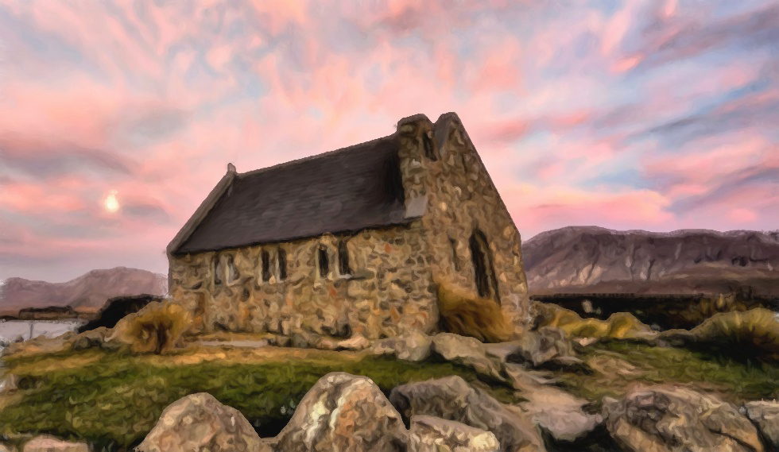
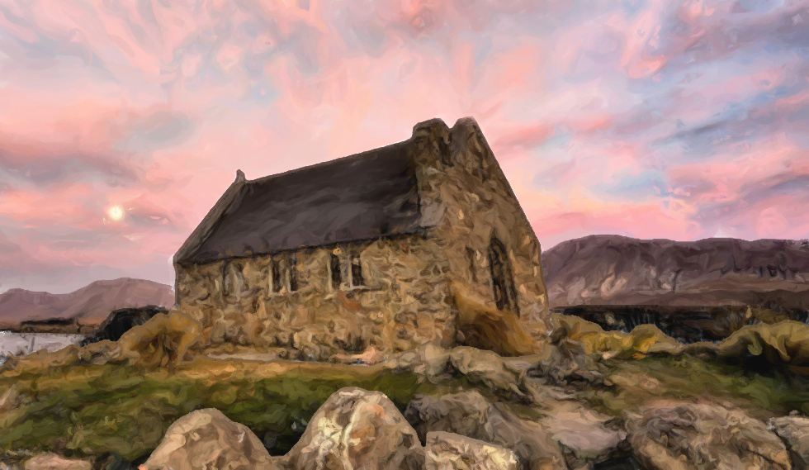
Results - Software - Comparison
Traditional method using three segments and blurring: 47201 strokes 23909 colors picked
Our method using three segments: 20107 strokes 8065 colors picked

Slide 18
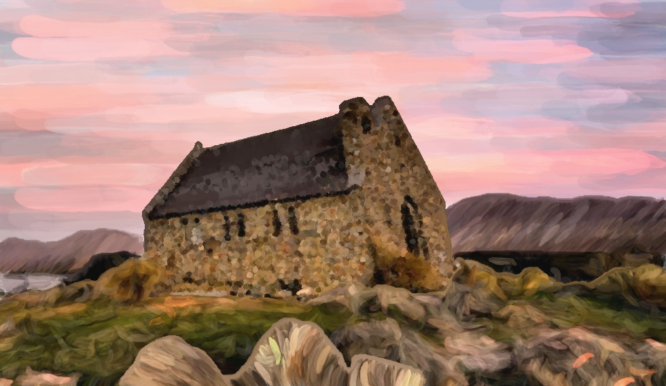
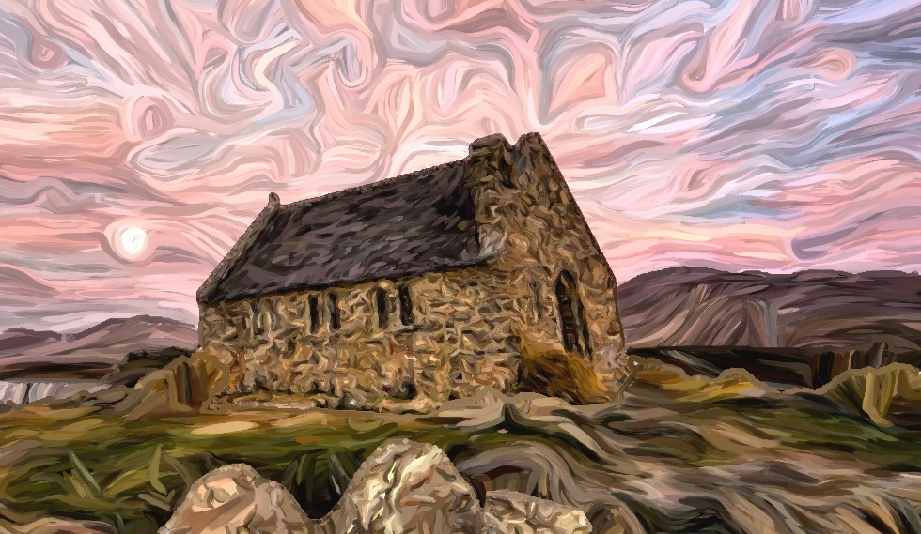
Results - Software - Style Variation
Larger strokes for background with fixed orientations Short small strokes for the house
Jittering of color and transformation of the orientation field for the sky

Slide 19
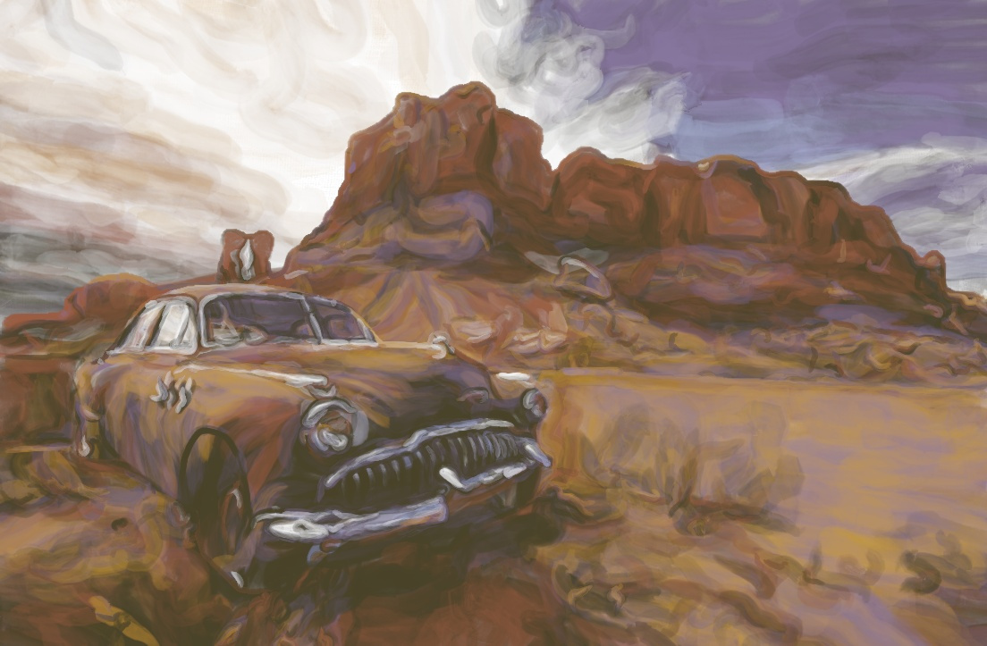
Results - Software - Limited Palette
Only seven colors used but high transparency
Is realizable by a painting machine

Slide 20
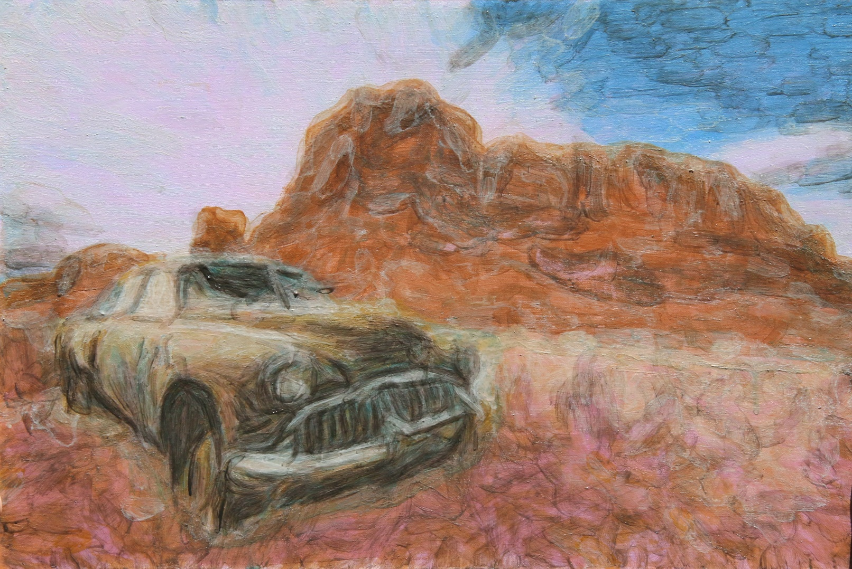
Results – e-David
Canvas board
Four colors mixed from: Lamp black, primary cyan, raw umber, vandyke brown, sand, titanium white, lilac and cadmium red
15703 strokes
15 hours
Notes:
@inproceedings{Deussen2012,
author = {Deussen, Oliver and Lindemeier, Thomas and Pirk, S\"{o}ren and Tautzenberger, Mark},
title = {Feedback-guided Stroke Placement for a Painting Machine},
booktitle = {Proceedings of the Eighth Annual Symposium on Computational Aesthetics in Graphics, Visualization, and Imaging},
series = {CAe '12},
year = {2012},
isbn = {978-1-4503-1584-5},
location = {Annecy, France},
pages = {25--33},
numpages = {9},
acmid = {2328894},
publisher = {Eurographics Association},
address = {Aire-la-Ville, Switzerland, Switzerland},
}
@article{Lindemeier2013,
abstract = {In this paper we present and evaluate painterly rendering techniques that work within a visual feedback loop of eDavid, our painting robot. The machine aims at simulating the human painting process. Two such methods and their semantics-driven combination are compared for different objects. One uses a predefined set of stroke candidates, the other creates strokes directly using line integral convolution. The aesthetics of these methods are discussed and results are shown.},
author = {Lindemeier, Thomas and Pirk, S{\"{o}}ren and Deussen, Oliver},
doi = {10.1016/j.cag.2013.01.005},
issn = {00978493},
journal = {Computers {\&} Graphics},
keywords = {image stylization,non-photorealistic rendering,painterly rendering,painting machine,visual feedback},
mendeley-groups = {archive/painting{\_}robot,archive/2013{\_}van{\_}Gogh{\_}project},
month = {aug},
number = {5},
pages = {293--301},
title = {Image Stylization with a Painting Machine Using Semantic Hints},
volume = {37},
year = {2013}
}
@article{Lindemeier2015a,
abstract = {We describe a painting machine and associated algorithms. Our modified industrial robot works with visual feedback and applies acrylic paint from a repository to a canvas until the created painting resembles a given input image or scene. The color differences between canvas and input are used to direct the application of new strokes. We present two optimization-based algorithms that place such strokes in relation to already existing ones. Using these methods we are able to create different painting styles, one that tries to match the input colors with almost transparent strokes and another one that creates dithering patterns of opaque strokes that approximate the input color. The machine produces paintings that mimic those created by human painters and allows us to study the painting process as well as the creation of artworks.},
author = {Lindemeier, Thomas and Metzner, Jens and Pollak, Lena and Deussen, Oliver},
doi = {10.1111/cgf.12562},
journal = {Computer Graphics Forum},
mendeley-groups = {2016{\_}PaintingLayers},
number = {2},
pages = {311--323},
title = {Hardware-Based Non-Photorealistic Rendering Using a Painting Robot},
volume = {34},
year = {2015}
}

Slide 21
Conclusion
Less strokes and colors used
Software renderers and painting machines
More artistic freedom
Limitations:
Reduced palette and opaque paint
Typical quantization problems
In the Future:
Mixing paint, optical blending
Additonal layering techniques, glaze..., highlights

Slide 22
Thank you!

Slide 23
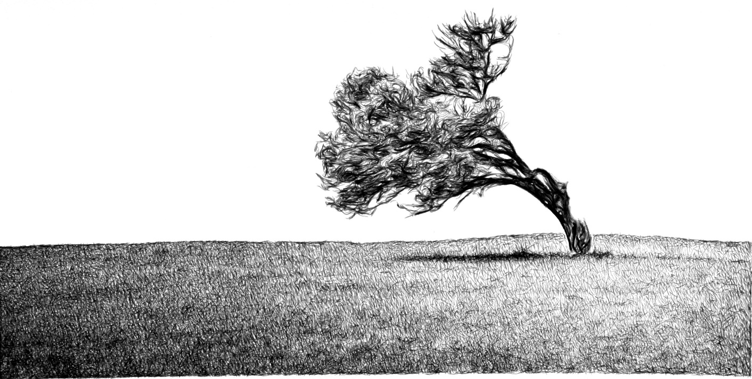
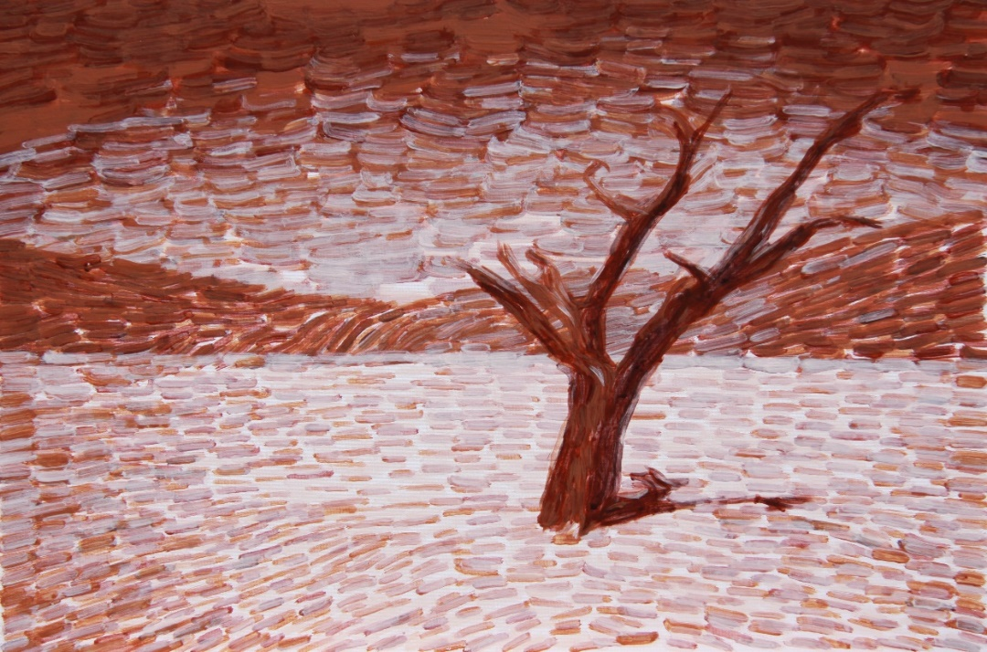
Painting Machines - e-David
Lindemeier et al. 2013
Lindemeier et al. 2015
Notes:
@article{Lindemeier2013,
abstract = {In this paper we present and evaluate painterly rendering techniques that work within a visual feedback loop of eDavid, our painting robot. The machine aims at simulating the human painting process. Two such methods and their semantics-driven combination are compared for different objects. One uses a predefined set of stroke candidates, the other creates strokes directly using line integral convolution. The aesthetics of these methods are discussed and results are shown.},
author = {Lindemeier, Thomas and Pirk, S{\"{o}}ren and Deussen, Oliver},
doi = {10.1016/j.cag.2013.01.005},
issn = {00978493},
journal = {Computers {\&} Graphics},
keywords = {image stylization,non-photorealistic rendering,painterly rendering,painting machine,visual feedback},
mendeley-groups = {archive/painting{\_}robot,archive/2013{\_}van{\_}Gogh{\_}project},
month = {aug},
number = {5},
pages = {293--301},
title = {Image Stylization with a Painting Machine Using Semantic Hints},
volume = {37},
year = {2013}
}
@article{Lindemeier2015a,
abstract = {We describe a painting machine and associated algorithms. Our modified industrial robot works with visual feedback and applies acrylic paint from a repository to a canvas until the created painting resembles a given input image or scene. The color differences between canvas and input are used to direct the application of new strokes. We present two optimization-based algorithms that place such strokes in relation to already existing ones. Using these methods we are able to create different painting styles, one that tries to match the input colors with almost transparent strokes and another one that creates dithering patterns of opaque strokes that approximate the input color. The machine produces paintings that mimic those created by human painters and allows us to study the painting process as well as the creation of artworks.},
author = {Lindemeier, Thomas and Metzner, Jens and Pollak, Lena and Deussen, Oliver},
doi = {10.1111/cgf.12562},
journal = {Computer Graphics Forum},
mendeley-groups = {2016{\_}PaintingLayers},
number = {2},
pages = {311--323},
title = {Hardware-Based Non-Photorealistic Rendering Using a Painting Robot},
volume = {34},
year = {2015}
}

Slide 24
Division into Regions – Painting Order
1
1
2
2
3
4
Ordering:
outside-in
Ordering:
top-bottom

Slide 25
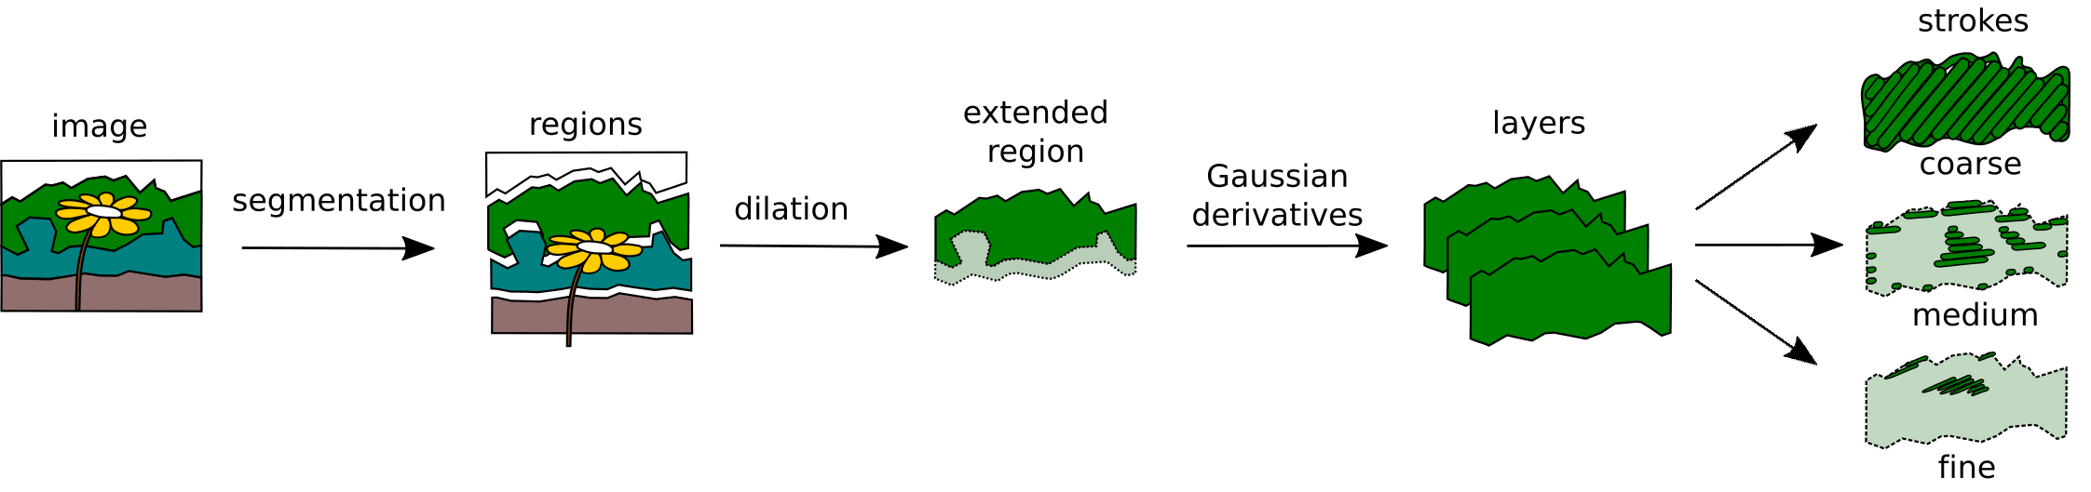
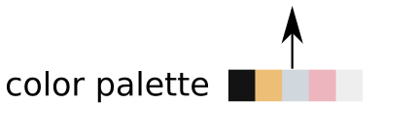
Overview

Slide 26
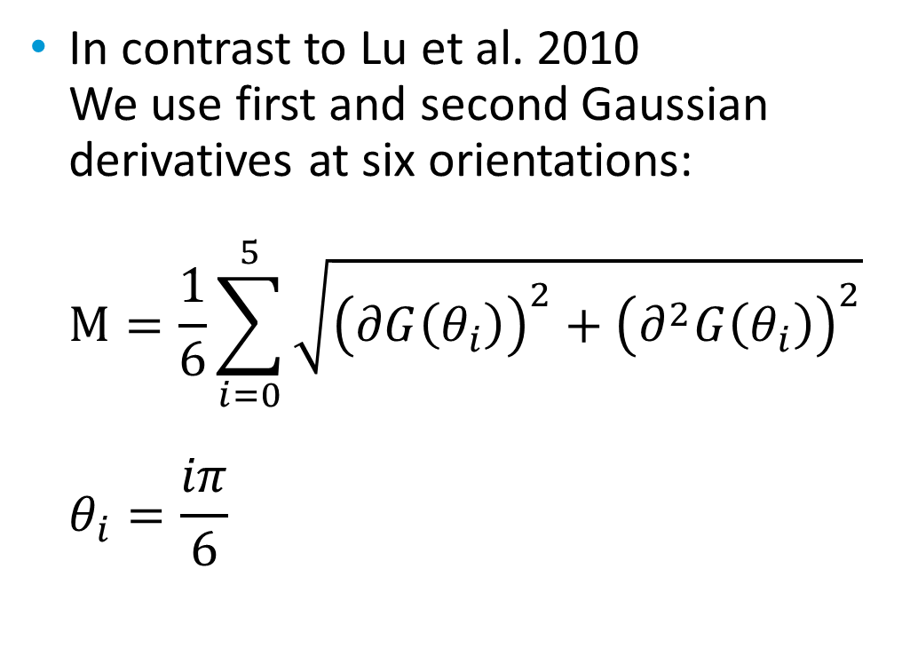
Division into Layers
Inspired by Lu et al. 2010
Feature detection
Thresholding the response
Masks for each detail layer
In contrast to Lu et al. 2010 We use first and second Gaussian derivatives at six orientations: $M=\frac{1}{6}\sum_{i=0}^{5}{\sqrt{{\left(∂G\left(θ_{i}\right)\right)}^{2}+{\left(∂^{2}G\left(θ_{i}\right)\right)}^{2}}}$ $θ_{i}=\frac{iπ}{6}$
Notes:
@inproceedings{Lu2010,
author = {Lu, Jingwan and Sander, Pedro V. and Finkelstein, Adam},
title = {Interactive Painterly Stylization of Images, Videos and 3D Animations},
booktitle = {Proceedings of the 2010 ACM SIGGRAPH Symposium on Interactive 3D Graphics and Games},
series = {I3D '10},
year = {2010},
isbn = {978-1-60558-939-8},
location = {Washington, D.C.},
pages = {127--134},
numpages = {8},
doi = {10.1145/1730804.1730825},
acmid = {1730825},
publisher = {ACM},
address = {New York, NY, USA},
keywords = {GPU processing, non-photorealistic rendering, painterly rendering, particle systems, video processing},
}

Slide 27
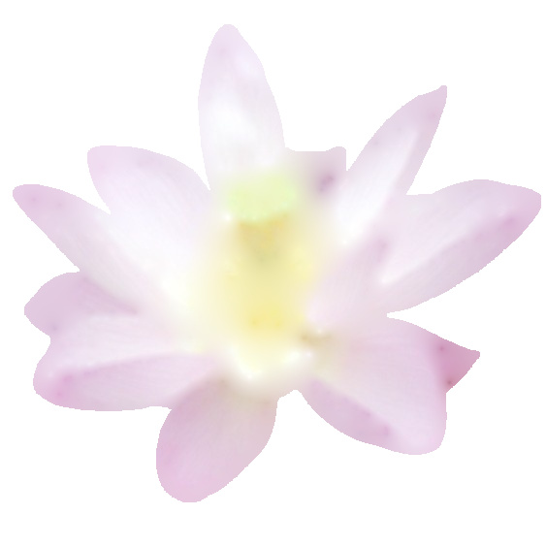
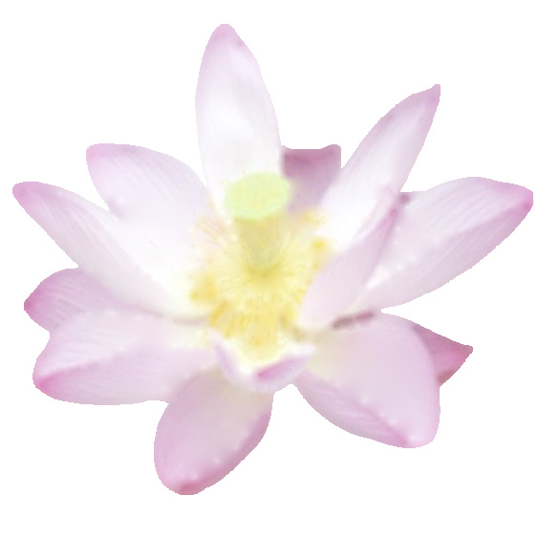
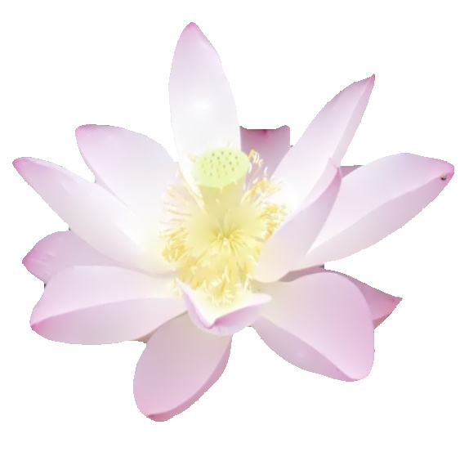
Division into Layers
Extraction
Color Interpolation
Input region flower
Fine
Coarse
Fine
Coarse
Medium
Medium

Slide 28

Rendering - Software
Standard software renderer...
Stroke textures, see Zeng et al. 2009
Color composition, see Baxter 2004
Normal mapping, Cook-Torrance Shader
Notes:
@inproceedings{Baxter2004,
author = {Baxter, William and Wendt, Jeremy and Lin, Ming C.},
title = {IMPaSTo: A Realistic, Interactive Model for Paint},
booktitle = {Proceedings of the 3rd International Symposium on Non-photorealistic Animation and Rendering},
series = {NPAR '04},
year = {2004},
isbn = {1-58113-887-3},
location = {Annecy, France},
pages = {45--148},
numpages = {104},
doi = {10.1145/987657.987665},
acmid = {987665},
publisher = {ACM},
address = {New York, NY, USA},
keywords = {Non-photorealistic rendering, painting systems, simulation of traditional graphical styles},
}

